Slide 1

SMS Spam Detection
Avneet Pal Kour
Nikhil Reddy Pathuri
Paras Sethi

Slide 2

Identification of the Problem and Opportunity
Spam as a Problem
Spams reduces the effectiveness legitimate advertising
Causes Cost Shifting
Fraud
Identity Theft
Changes Consumer Perception
Global Implications
Benefits to solving this problem:
By detecting spam messages we will be able to avoid problems like Unsolicited advertising, Inappropriate or adult-themed content, Premium rate fraud, Smishing and Mobile Malware
Priori hypotheses:
In past spam detection was solely based on comparing key words which appear frequently in such messages, some used the length of the messages and few others took advantage utilizing a blacklist. Efficiency of these techniques was only about 60-70% and most of these anti spam systems used techniques which miss lot of spams in order to reduce good message rejection.

Slide 3
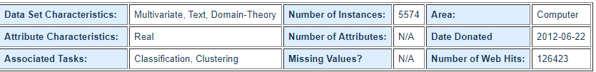
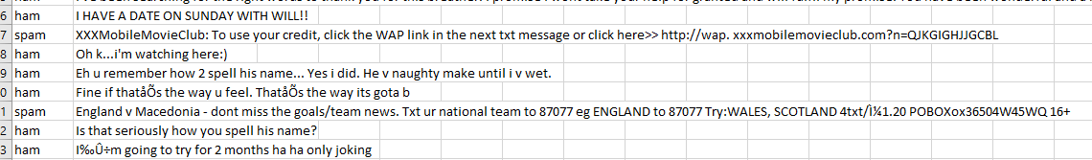
Data
The dataset that we have used is SMS Spam Collection Data Set available on UCI machine learning academy.
This data has been collected from free for research sources comprising of:
A subset of 3,375 SMS which is a dataset of about 10,000 legitimate messages collected for research at the Department of Computer Science at the National University of Singapore.
A collection of 425 SMS spam messages was manually extracted from the Grumbletext Web site.
A list of 450 SMS ham messages collected from Caroline Tag's PhD Thesis
Public available 1,002 SMS ham messages and 322 spam messages and it is public available
PREVIEW OF DATASET

Slide 4
Technical Approach
Tokenization
Removing stop words
Stemming
Converting to lower case
Building a TDM
Applying classifying algorithms:
Loading data to R.
Split data
The data in a csv file is loaded to R.
Splitting the text by white spaces and punctuation marks.
These words don’t have much content.
So that the classifier does not treat them as separate entities.
Linking the different forms of the same root word.
describes the frequency of terms that occur in a collection
Split the data into test and train sets.
Classify using:
Naïve Bayes and
SVM algorithms

Slide 5
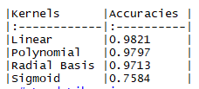

Technical Approach-Cond
Naïve Bayes
Create the bag of words.
Rank all the words according to their occurrence in the data set.
Calculate the likelihood P(wt | C=k).
Estimate the posterior probability for each word.
The class which matches the word with the highest posterior probability is the outcome of prediction. We measure by using the below formula:
Support vector Machines(SVM)
Trained our model with train data using SVM algorithm with four kernels namely:
Linear
Polynomial
Radial
Sigmoid
We predicted the results of the test data using above model for all the four kernels.
We got the maximum accuracy with the linear kernel as shown below:

Slide 6
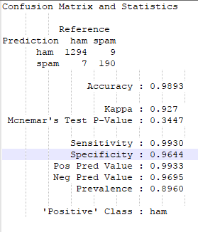
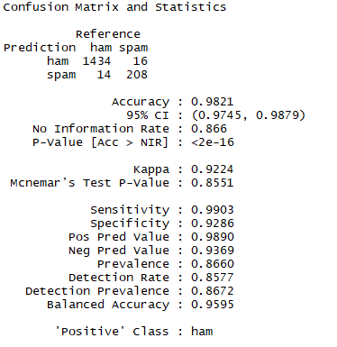
Metrics and Results
Naïve Bayes
Support vector Machines(SVM)

Slide 7
Conclusion
Numerous techniques exist, but none is a “good for all scenario” technique.
Data Mining approached for content based spam filtering are promising
It can be trained as per the user-basis: the spam that a user receives is often based on the user activities.

Slide 8


QUESTIONS?

